Slide 1
Crystal lake’s mansion
Producer: Jermo
Lead Artist & Scrum: Stanley
UX: Jorrit & Stefan
Lead Programmer: Daniel

Slide 2
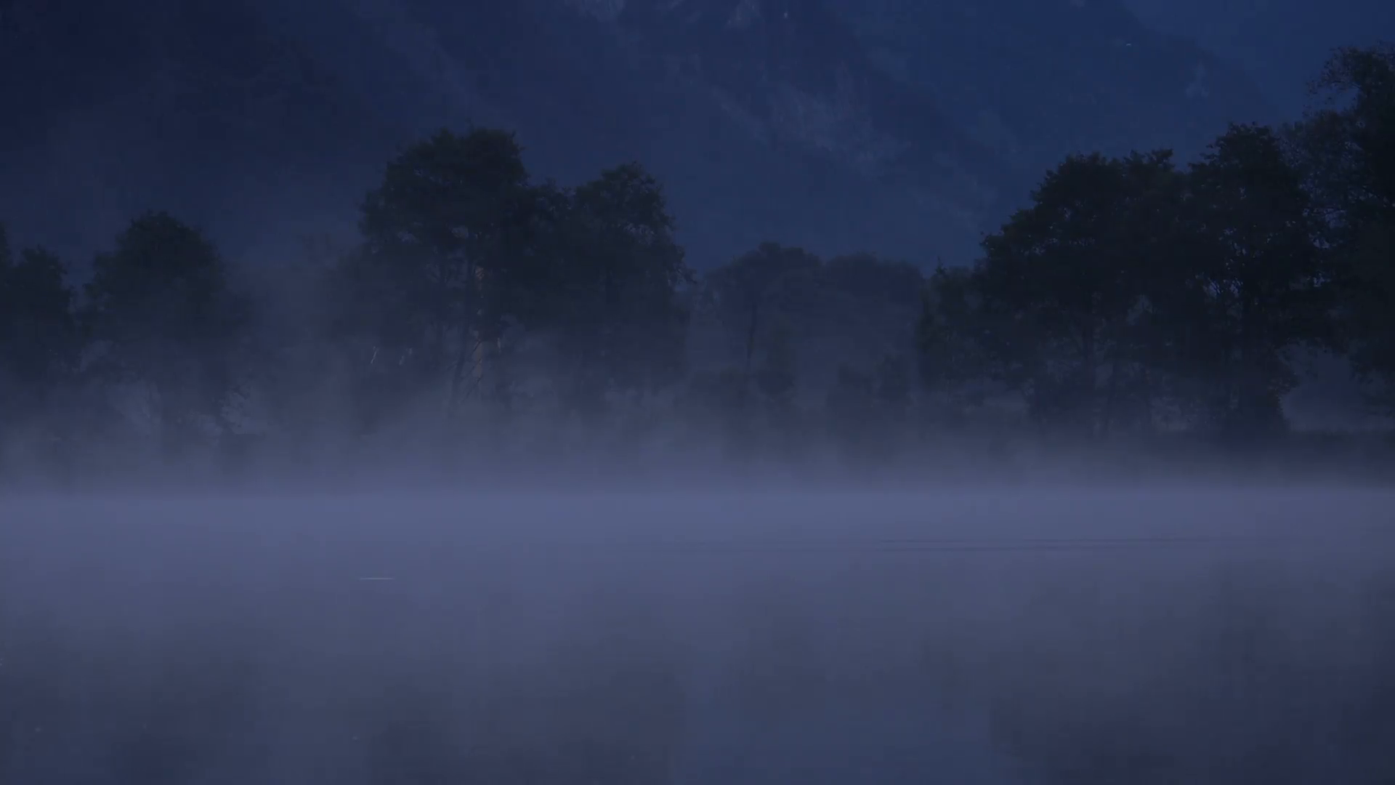
Inhoud
Over de game
Terugblikken
Groep
Jermo
Stanley
Jorrit
Stefan
Daniël
Game Presentatie

Slide 3
Over de game
Horror / Hide seek thriller
Find notebooks
Run from the monster

Slide 4
Groep
Planning
Samenwerking
Ups
Downs

Slide 5
Jermo
Art

Slide 6
Stanley
SCRUM
Trello Moscow
Mowscow
Aanwezigheid

Slide 7
Stanley
Art
Animation
Guestroom
Master bedroom
Kitchen

Slide 8
Jorrit
U.X.
Implementation
Testing
Sound
Lighting

Slide 9
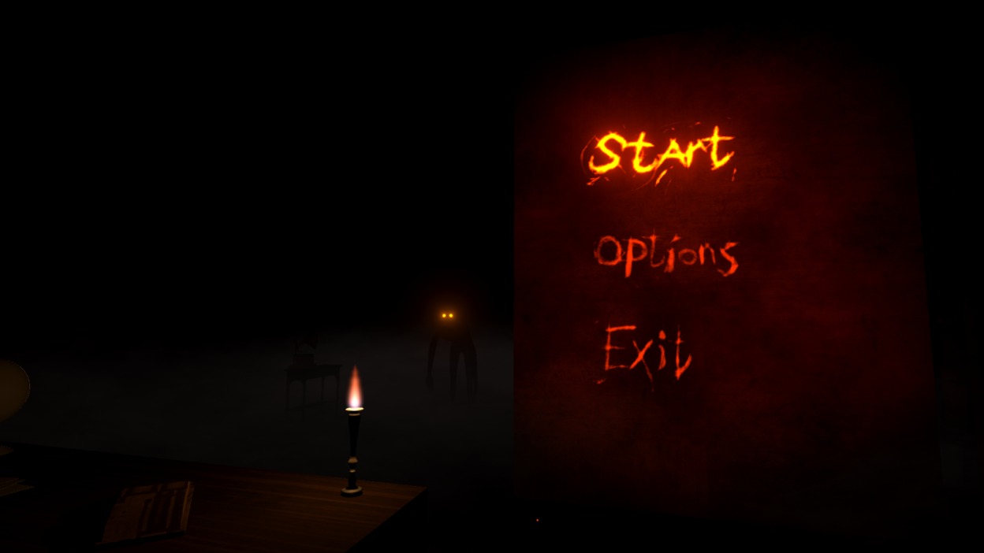
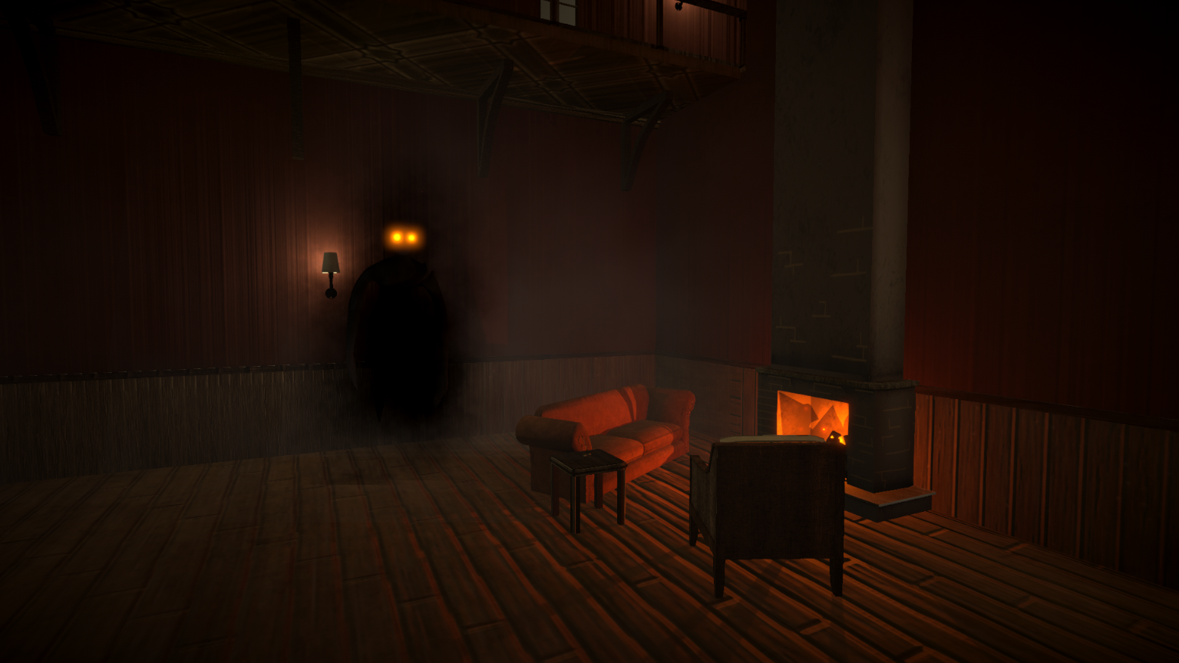
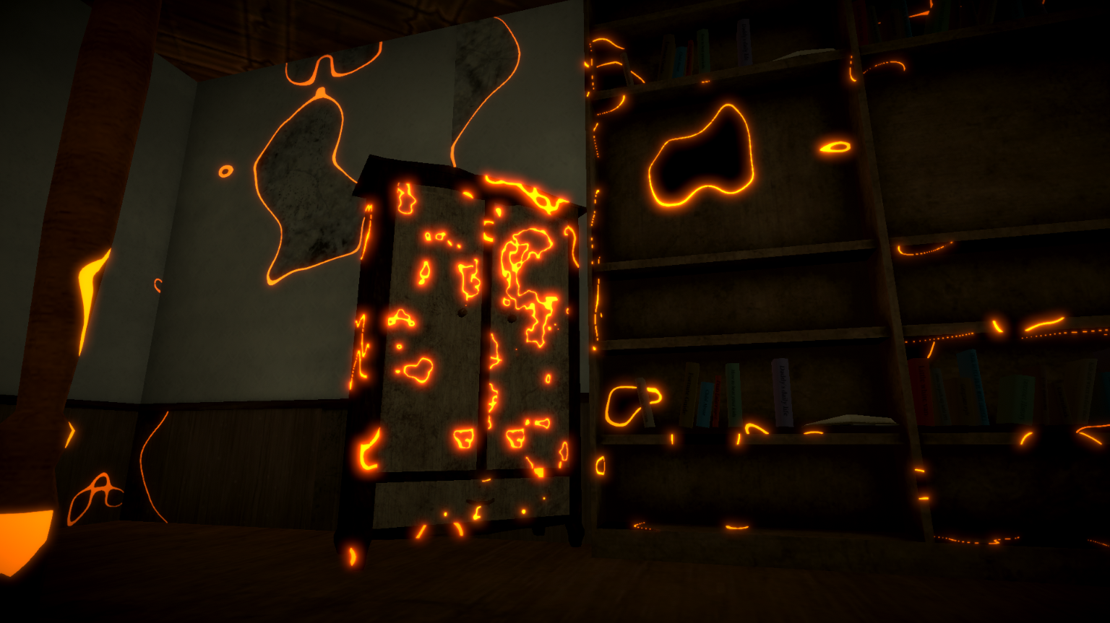
Stefan
U.X.
Main Menu
Effects
Shaders
Lighting

Slide 10
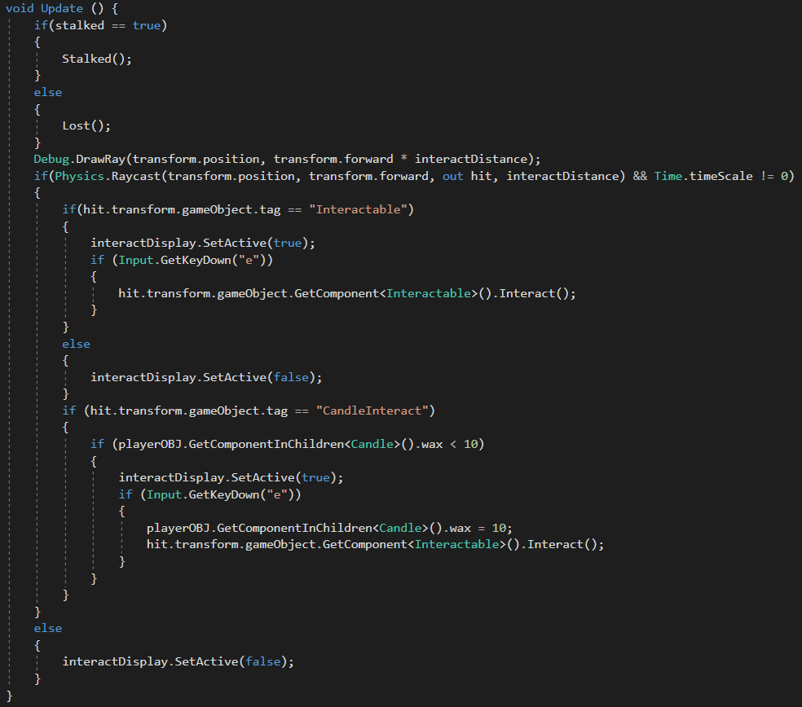
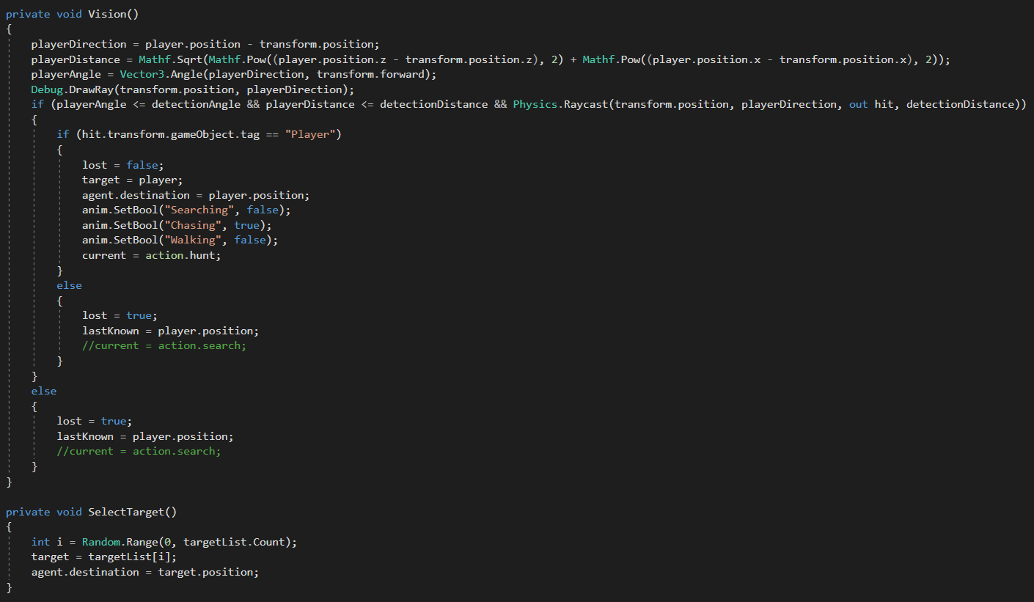
Daniel
Progamming
Simplest AI

